Slide 1
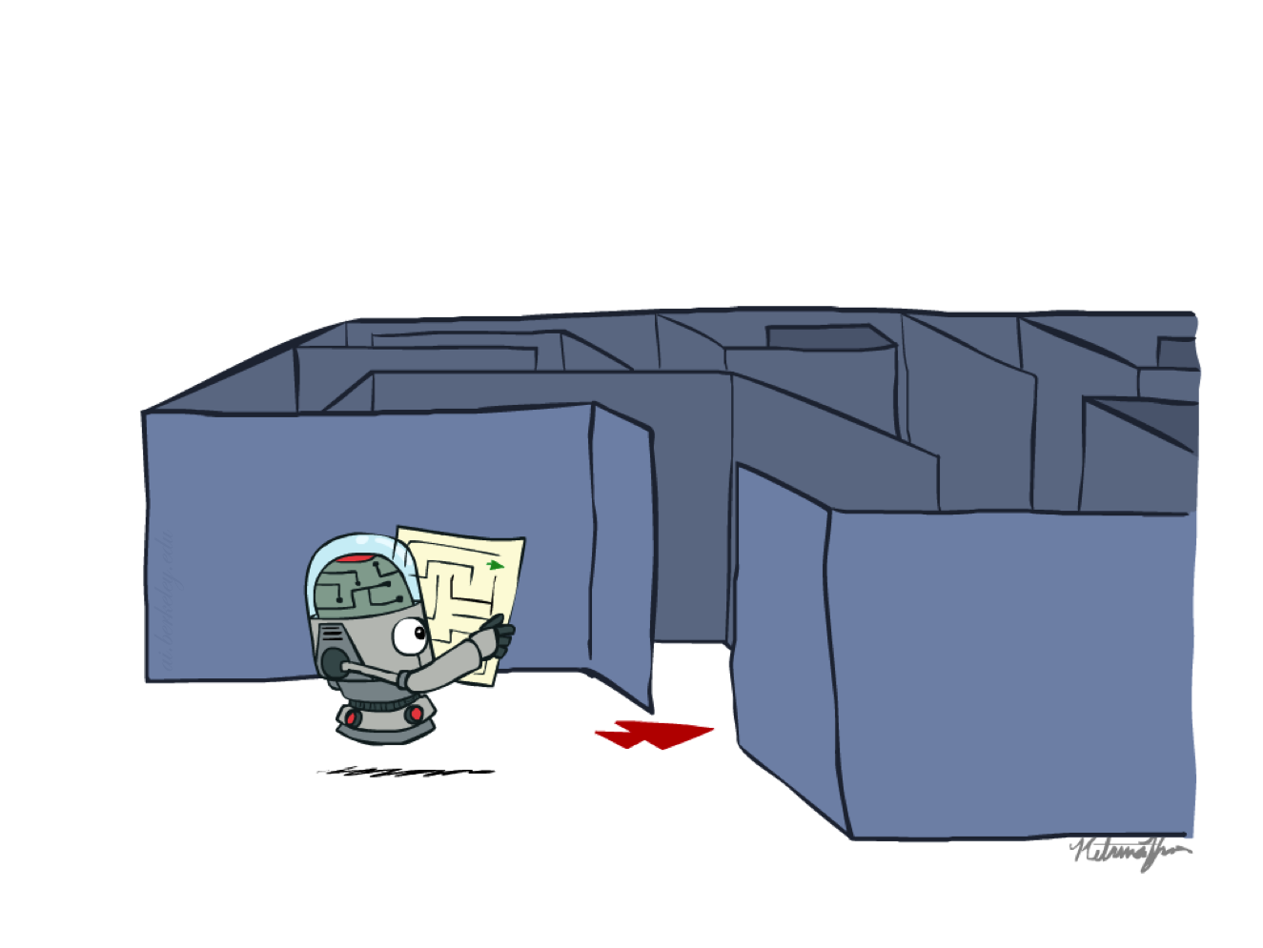

Chapter 1a
Search Problem and Uninformed Search
COMP 7404C
Computational Intelligence and Machine Learning
K.P. Chow & Dirk Schnieders
Most materials in this chapter are based on materials from http://aima.cs.berkeley.edu/ and http://ai.berkeley.edu
http://ai.berkeley.edu

Slide 2
Outline
Abstraction
Types of Search
Search Problem Definition
State Space Graph vs. Search Tree
Search Algorithm (TSA, GSA)
Uninformed Search
BFS, DFS, UCS
Informed Search
Greedy, A*
Local Search
Constraint Satisfaction Problems
Adversarial Search
Minimax
DLS
Horizon Effect
𝛼-𝛽 Pruning
Expectimax
Multi-Agent Utilities

Slide 3
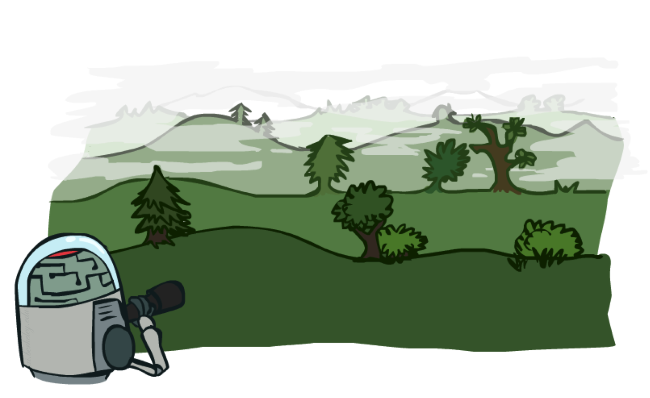
http://ai.berkeley.edu

Slide 4

Abstraction
Search problems are models
Simplifications of the real world
Don’t deal with the unnecessary complexities of the real world
World states vs. search states
http://ai.berkeley.edu

Slide 5
Types of Search
Uninformed search
No information about the problem other than its definition is given
Informed search
A heuristic is used that leads to better overall performance in getting to the goal state
Local Search
Evaluate and modify a current state to move closer to a goal state
Constraint Satisfaction Problems
For certain types of problems we can search for solution faster by understanding states better
Adversarial Search
Search in the presence of an adversary
Notes:
Uninformed: DFS, BFS, UCS (Like Brute Force, don’t know where the goal is)
Informed: Greedy Search, A* (We are using some knowledge of the goal)
Local Search: Gradient Descent
CSP: AC-3
Adversarial Search: Alpha-Beta Pruning

Slide 6
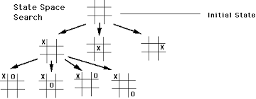
Search Problem Definition
States: Details of what constitutes a state
Initial state: The state the agent starts in
Actions and transition model
Description of possible actions available
Description of what each action does
Goal test: Is a given state a goal state?
Path cost: A function that assigns a zero or positive numeric cost to each path
A solution is a sequence of actions (a plan) which transforms the start state to a goal state

Slide 7
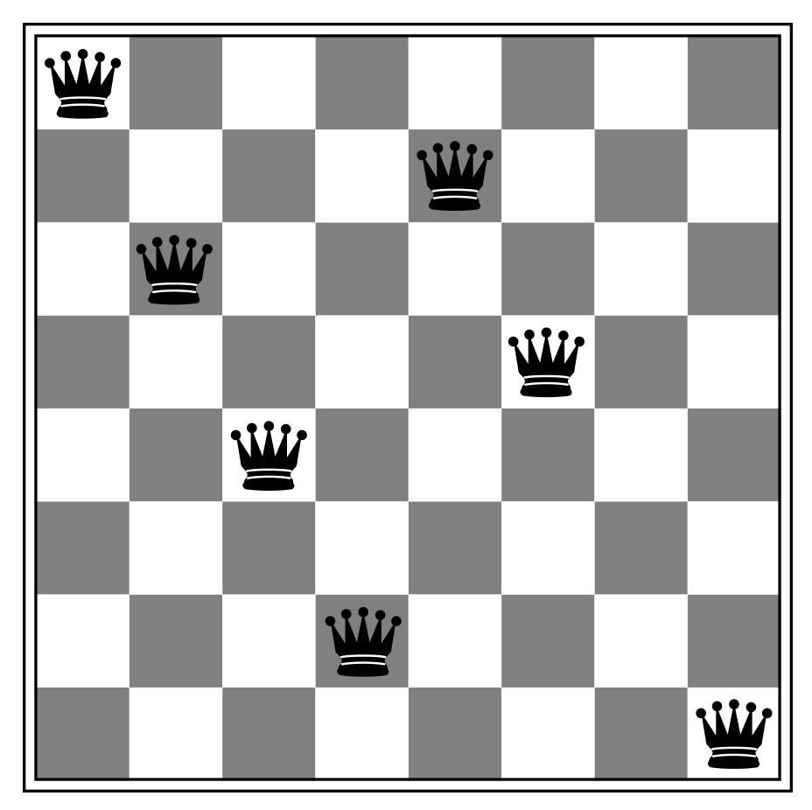
N Queens Puzzle - An Example Problem
Problem Definition A
States
Any arrangement of 0 to n queens on the board
Initial state
No queens on the board
Actions and Transition model
Add a queen to an empty square
Goal test
n queens are on the board, none attacked
Eight Queens Puzzle on Wikipedia
http://aima.cs.berkeley.edu/

Slide 8
N Queens Puzzle - An Example Problem
Problem Definition B
States
One queen per column, none attacking another
Initial state
No queens on the board
Actions and Transition model
Add a queen to an empty column such that no other queen is under attack
Goal test
n queens are on the board

Slide 9
State Space
The set of all states reachable from the initial state by any sequence of actions is the state space
Usually a graph
The possible action sequences form a search tree
The nodes are states, and the links between nodes are actions
A solution is a sequence of actions (i.e., a path) leading from the initial state to a goal state
Task: Which state space has more states?
Problem Definition A
Problem Definition B

Slide 10
Same problem,
different models,
different state spaces
Let’s look at another game!

Slide 11

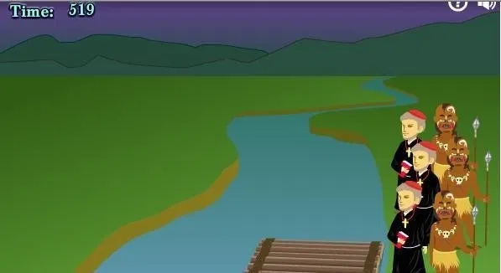
Cannibals and Missionaries Game
3 missionaries and 3 cannibals must cross a river using a boat which can carry at most two people, under the constraint that, for both banks, if there are missionaries present on the bank, they cannot be outnumbered by cannibals
What is a state?
What are the actions?
What is the initial state?
What is the goal state?

Slide 12
Cannibals and Missionaries Game – States
What other actions?
(2,0)
(0,2)
(1,0)
(0,1)
(0,0) ?
Initial State (Bank2, Bank1)
((0,0,0), (3,3,1))
Action
Bank1 to Bank2
(1,1)
Goal State (Bank2, Bank1)
((3,3,1), (0,0,0))
Next State (Bank2, Bank1)
((1,1,1), (2,2,0))

Slide 13
State Space Graph vs. Search Tree
State space graph
A mathematical representation of a search problem
Nodes are (abstracted) world configurations
Arcs represent successors (action results)
The goal test is a set of goal nodes
Each state occurs only once
Search tree
Root of the tree is the start state
Nodes represent the possible action sequences
States may occur more than once

Slide 14
State Space Graph vs. Search Tree
Consider the following state space graph
Let S be the start state and G be the goal state
Task: Draw the complete search tree
a
S
G
b

Slide 15
How about the Cannibals and Missionaries Game?

Slide 16
States vs. State Sequences
A large state space results in a huge number of state sequences
I.e., a large number of nodes in the search tree
Example: Chess
Claude Shannon estimated 10⁴³ possible states and 10¹²⁰ possible state sequences in his 1950 paper “Programming a Computer for Playing Chess”
“There are only 10¹⁵ total hairs on all the human heads in the world, 10²³ grains of sand on Earth, and about 10⁸¹ atoms in the universe. The number of typical chess games is many times as great as all those numbers multiplied together - an impressive feat for 32 wooden pieces lined up on a board.”
Extracted from: Answers to the World's Greatest Questions, By Bjorn Carey
Notes:
---
Quote taken from https://www.popsci.com/science/article/2010-12/fyi-how-many-different-ways-can-chess-game-unfold

Slide 17
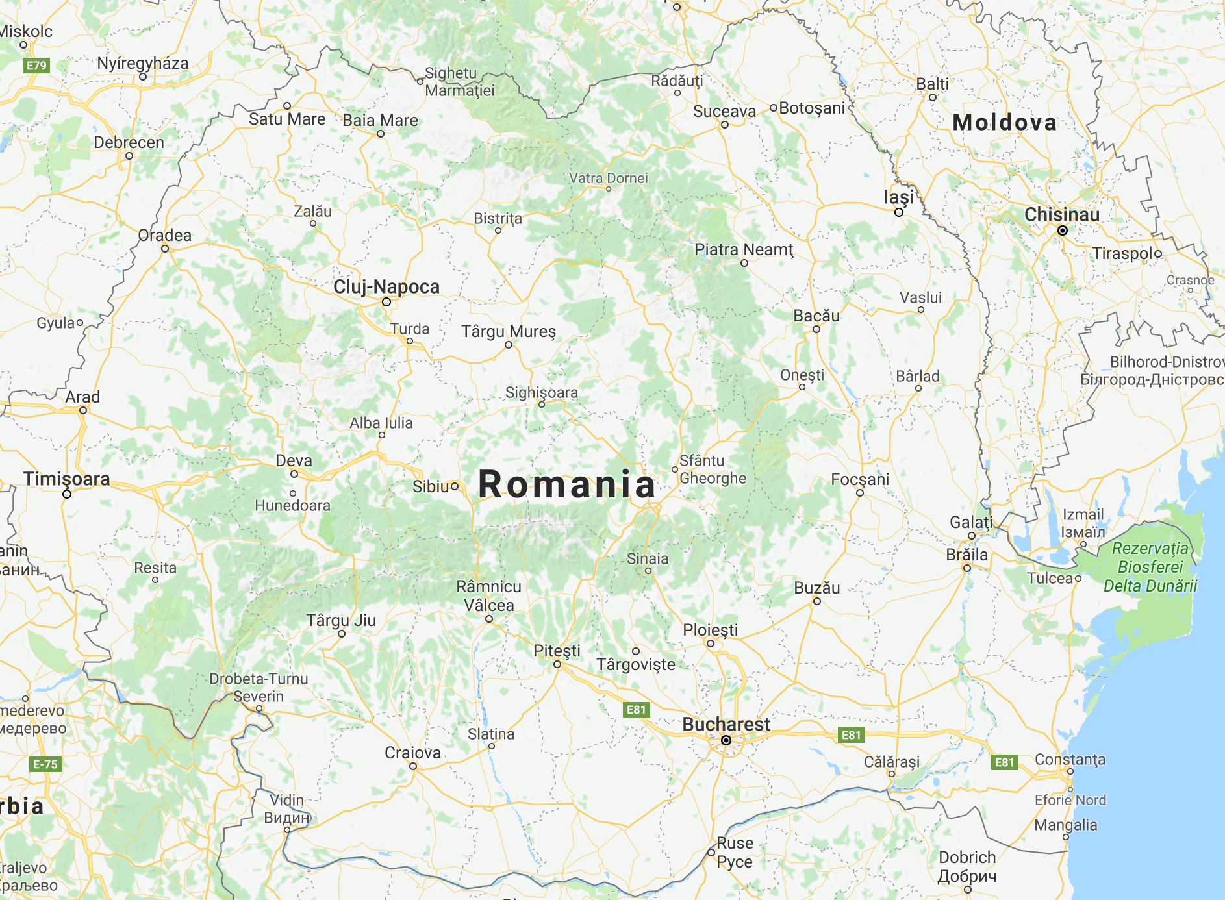
Romania Problem - A Toy Problem
States
The cities
Initial state
Arad
Actions and Transition model
Go to neighboring city
Goal test
In Bucharest?
Path cost
Distance between the cities
www.google.com/maps/place/Romania/
Notes:
For the Eight-Queen and Chess have way too many states.
We need something smaller to explain search algorithms.
---
Image extracted from Textbook

Slide 18
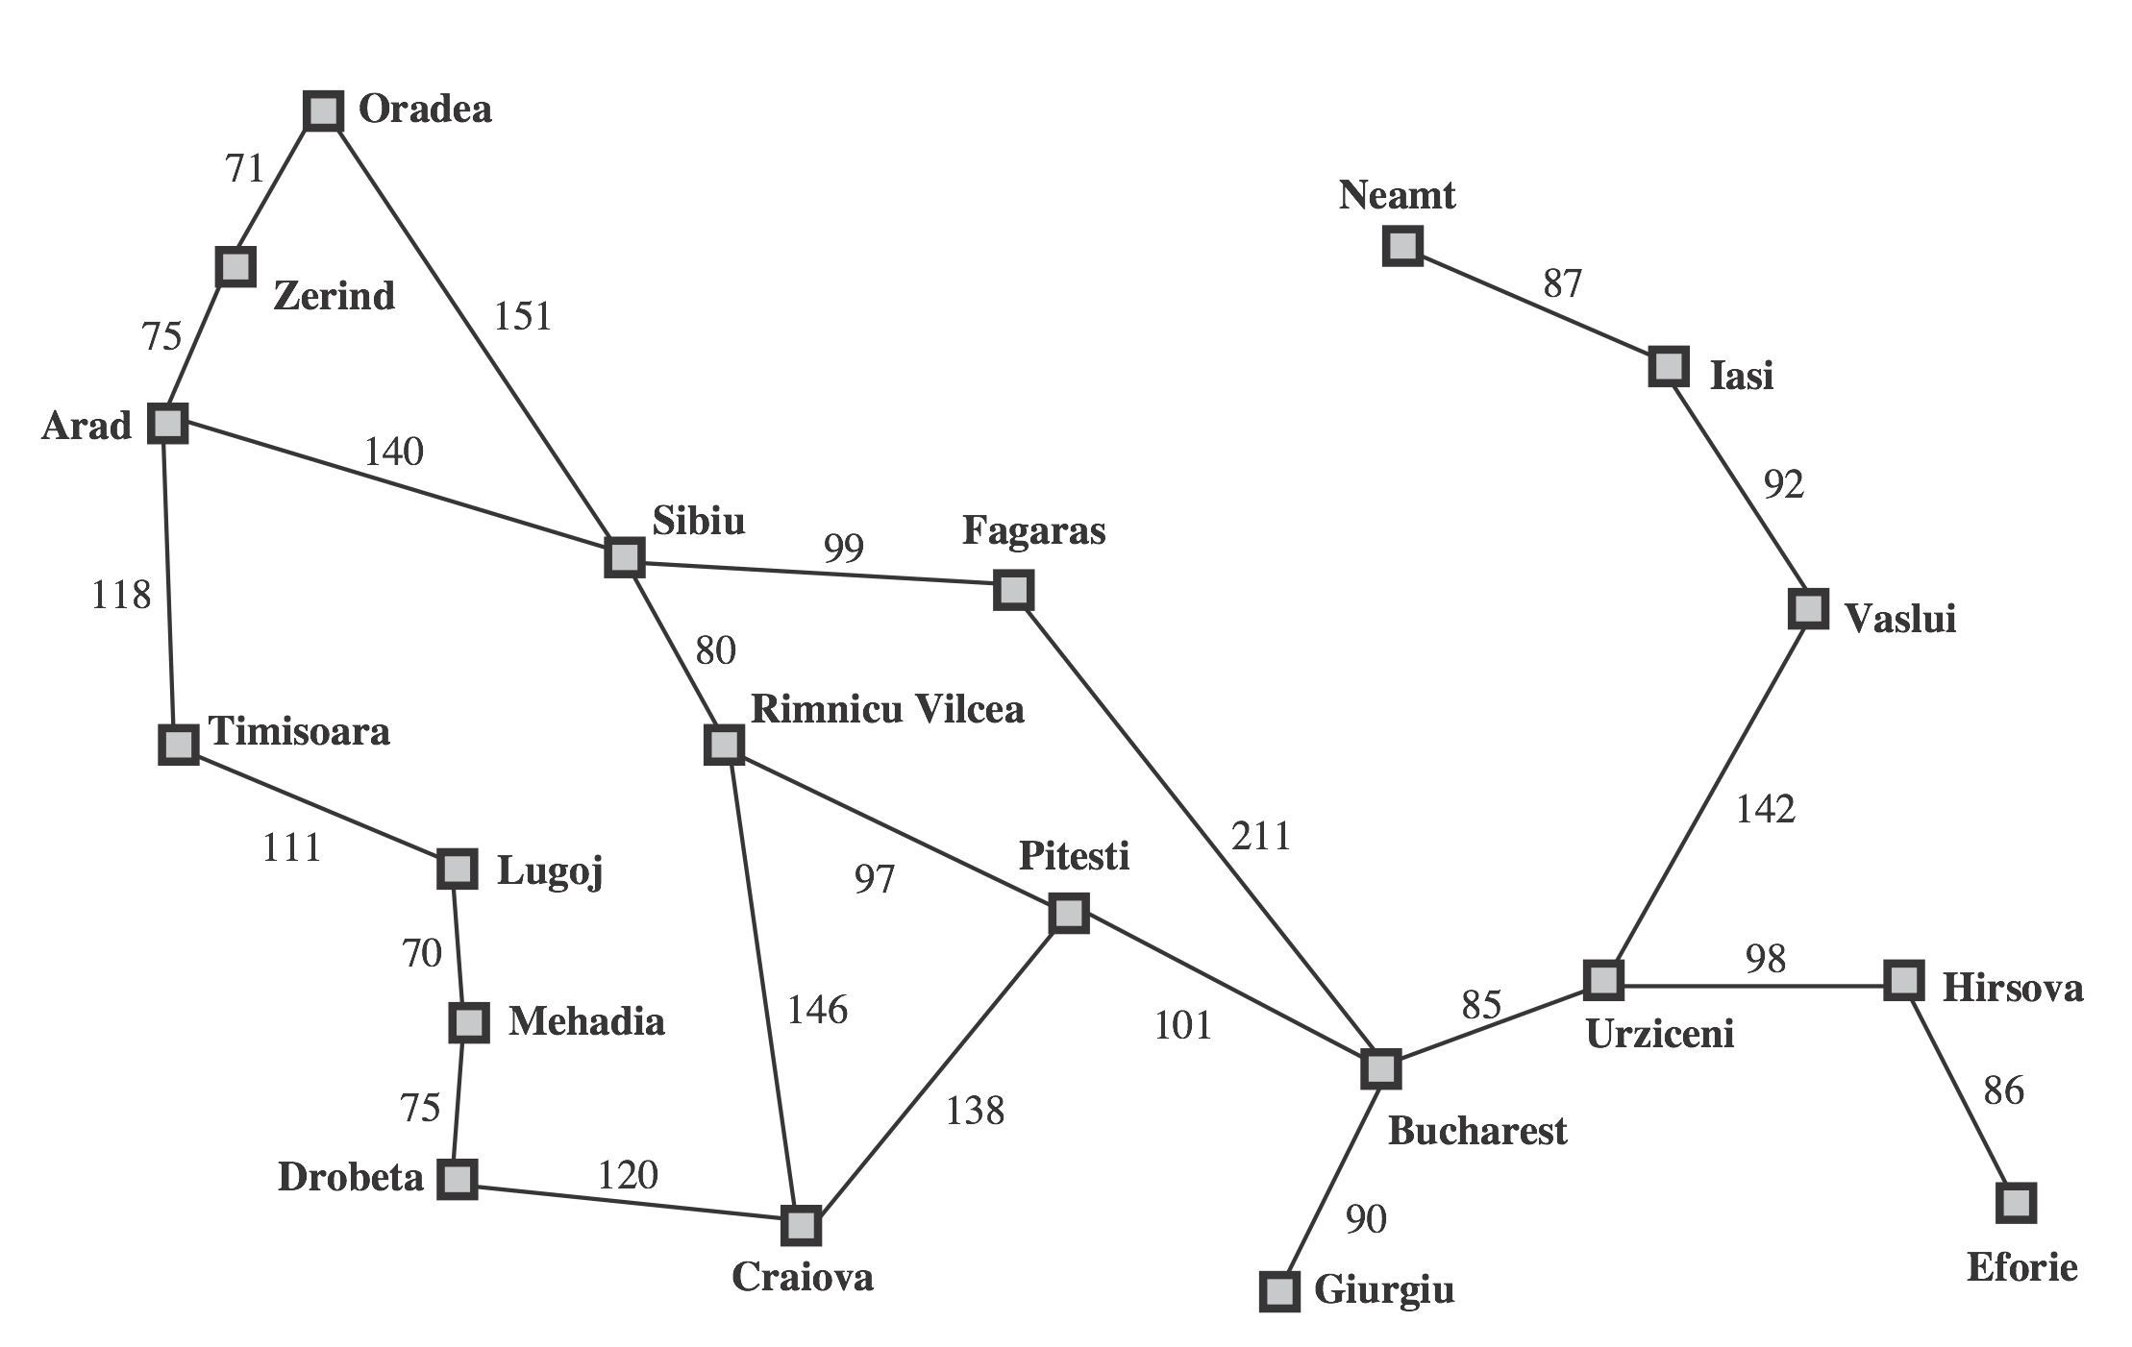
Romania Problem - State Space
http://aima.cs.berkeley.edu/
Notes:
---
Image extracted from Textbook

Slide 19
Romania Problem Definition
A can go to [S, T, Z]
Z can go to [A, O]
Adjacency list
Use dictionary to store neighbors for each cities
>>> romania['A'] ['S', 'T', 'Z']
romania = { 'A':['S','T','Z'],'Z':['A','O'],'O':['S','Z'],'T':['A','L'],'L':['M','T'],'M':['D','L'], 'D':['C','M'],'S':['A','F','O','R'],'R':['C','P','S'],'C':['D','P','R'], 'F':['B','S'],'P':['B','C','R'],'B':[] }

Slide 20
Search Strategy
The search strategy defines the order of node expansion
I.e., the order in which nodes in the search tree are discovered
Search strategies are evaluated along the following dimensions
Completeness: Always find a solution if one exists?
Optimality: Always find a least-cost solution?
Time complexity: Number of nodes generated (= edges traversed)
Space complexity: Max number of nodes in memory
Time / space complexity are measured in terms of
b: maximum branching factor of the search tree
d: distance to root of the shallowest solution
m: maximum length of any path in the state space

Slide 21
Uninformed (Blind) Search Strategies
Uninformed search strategies (also called blind search) use only the “information” available in the problem definition
Examples
Breadth-first search (BFS)
Depth-first search (DFS)
Uniform-cost search (UCS)

Slide 22
Search Algorithms
Search algorithms come in two different flavors
Tree search algorithm (TSA)
Graph search algorithm (GSA)

Slide 23
Tree Search Algorithm (TSA)
What is the structure of the frontier?
How to choose?
function TSA(problem) returns solution initialize frontier using initial state of problem while frontier is not empty choose a node and remove it from frontier if node contains a goal state then return corresponding solution explore the node, adding the resulting nodes to the frontier
How to add?

Slide 24
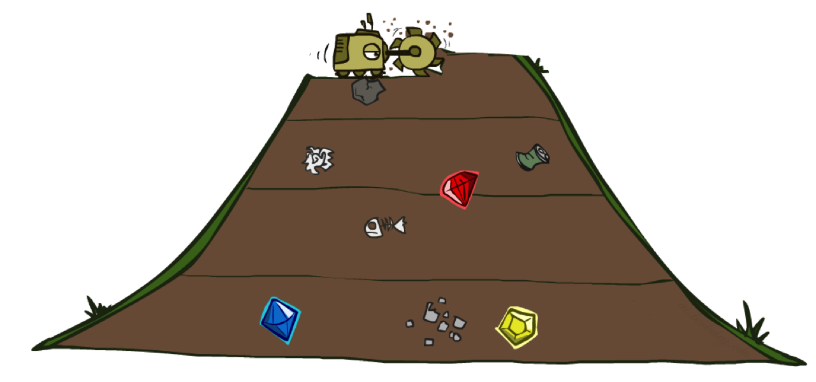
BFS
The BFS search strategy explores the shallowest node in the search tree
http://ai.berkeley.edu
frontier is a queue (first in first out data structure)

Slide 25
Queue in Python
We are going to use the deque in Python
Example usage:
What is deque?
>>> import collections >>> queue = collections.deque(['A', 'B', 'C', 'D']) >>> queue.popleft() 'A' >>> queue deque(['B', 'C', 'D']) >>> queue.popleft() 'B' >>> queue deque(['C', 'D'])

Slide 26
Examples
In the following examples we will use
characters for states, e.g,
'S'
'a'
strings for state sequences
'Sa'
'SabG'
a
S
G
b

Slide 27
Tree Search Algorithm (TSA) - BFS Version
function TSA(problem) returns solution initialize frontier using initial state of problem while frontier is not empty choose a node and remove it from frontier if node contains a goal state then return corresponding solution explore the node, adding the resulting nodes to the frontier
import collections def bfsTsa(stateSpaceGraph, startState, goalState): frontier = collections.deque([startState]) while frontier: node = frontier.popleft() if (node.endswith(goalState)): return node for child in stateSpaceGraph[node[-1]]: frontier.append(node+child)

Slide 28
BFS-TSA Romania Code
Try it here, Download bfsTsaRomania.py
import collections def bfsTsa(stateSpaceGraph, startState, goalState): frontier = collections.deque([startState]) print('Initial frontier:',list(frontier)) input() while frontier: node = frontier.popleft() if (node.endswith(goalState)): return node print('Exploring:',node[-1],'...') for child in stateSpaceGraph[node[-1]]: frontier.append(node+child) print(list(frontier)) input() romania = { 'A':['S','T','Z'],'Z':['A','O'],'O':['S','Z'],'T':['A','L'],'L':['M','T'],'M':['D','L'], 'D':['C','M'],'S':['A','F','O','R'],'R':['C','P','S'],'C':['D','P','R'], 'F':['B','S'],'P':['B','C','R'],'B':[] } print('Solution path:',bfsTsa(romania, 'A', 'B'))
http://aima.cs.berkeley.edu/

Slide 29
BFS-TSA
Romania
Initial frontier: ['A'] Exploring: A ... ['AS', 'AT', 'AZ'] Exploring: S ... ['AT', 'AZ', 'ASA', 'ASF', 'ASO', 'ASR'] Exploring: T ... ['AZ', 'ASA', 'ASF', 'ASO', 'ASR', 'ATA', 'ATL'] Exploring: Z ... ['ASA', 'ASF', 'ASO', 'ASR', 'ATA', 'ATL', 'AZA', 'AZO'] Exploring: A ... ['ASF', 'ASO', 'ASR', 'ATA', 'ATL', 'AZA', 'AZO', 'ASAS', 'ASAT', 'ASAZ'] ...
http://aima.cs.berkeley.edu/

Slide 30
Will bfsTsa(romania, 'A', 'B') terminate ?

Slide 31
Graph Search Algorithm (GSA) - BFS Version
function GSA (problem) returns solution initialize frontier using initial state of problem initialize explored set to be empty while frontier is not empty choose a node and remove it from frontier if node contains a goal state then return corresponding solution If node is not in explored set add node to explored set explore the node, adding the resulting nodes to the frontier
import collections def bfsGsa(stateSpaceGraph, startState, goalState): frontier = collections.deque([startState]) exploredSet = set() while frontier: node = frontier.popleft() if (node.endswith(goalState)): return node if node[-1] not in exploredSet: exploredSet.add(node[-1]) for child in stateSpaceGraph[node[-1]]: frontier.append(node+child)

Slide 32
import collections def bfsGsa(stateSpaceGraph, startState, goalState): frontier = collections.deque([startState]) exploredSet = set() print('Initial frontier:',list(frontier)) input() while frontier: node = frontier.popleft() if (node.endswith(goalState)): return node if node[-1] not in exploredSet: print('Exploring:',node[-1],'...') exploredSet.add(node[-1]) for child in stateSpaceGraph[node[-1]]: frontier.append(node+child) print(list(frontier)) print(exploredSet) input() romania = { 'A':['S','T','Z'],'Z':['A','O'],'O':['S','Z'], 'T':['A','L'],'L':['M','T'],'M':['D','L'], 'D':['C','M'],'S':['A','F','O','R'], 'R':['C','P','S'],'C':['D','P','R'], 'F':['B','S'],'P':['B','C','R'],'B':[] } print('Solution path:',bfsGsa(romania, 'A', 'B'))

Slide 33
http://aima.cs.berkeley.edu/
Initial frontier: ['A'] Exploring: A ... ['AS', 'AT', 'AZ'] {'A'} Exploring: S ... ['AT', 'AZ', 'ASA', 'ASF', 'ASO', 'ASR'] {'S', 'A'} Exploring: T ... ['AZ', 'ASA', 'ASF', 'ASO', 'ASR', 'ATA', 'ATL'] {'S', 'A', 'T'} Exploring: Z ... ['ASA', 'ASF', 'ASO', 'ASR', 'ATA', 'ATL', 'AZA', 'AZO'] {'S', 'A', 'Z', 'T'} Exploring: F ... ['ASO', 'ASR', 'ATA', 'ATL', 'AZA', 'AZO', 'ASFB', 'ASFS'] {'A', 'Z', 'T', 'S', 'F'} Exploring: O ... ['ASR', 'ATA', 'ATL', 'AZA', 'AZO', 'ASFB', 'ASFS', 'ASOS', 'ASOZ'] {'A', 'Z', 'T', 'S', 'O', 'F'} Exploring: R ... ['ATA', 'ATL', 'AZA', 'AZO', 'ASFB', 'ASFS', 'ASOS', 'ASOZ', 'ASRC', 'ASRP', 'ASRS'] {'A', 'R', 'Z', 'T', 'S', 'O', 'F'} Exploring: L ... ['AZA', 'AZO', 'ASFB', 'ASFS', 'ASOS', 'ASOZ', 'ASRC', 'ASRP', 'ASRS', 'ATLM', 'ATLT'] {'A', 'R', 'L', 'Z', 'T', 'S', 'O', 'F'} Solution path: ASFB
Try it here, bfsTsaRomania.py, bfsGsaRomania.py

Slide 34
BFS-GSA Practice
Consider the following state space graph
Let S be the start state and G be the goal state
Perform BFS-GSA and write down the order of explored states
Assume children are added into the frontier in alphabetical order
10
5
2
a
b
c
4
3
S
1
1
G
3
2
4
d
e

Slide 35
BFS-GSA Practice Solution
Initial frontier: ['S'] Exploring: S ... ['Sa', 'Sd', 'SG'] {'S'} Exploring: a ... ['Sd', 'SG', 'Sab'] {'S', 'a'} Exploring: d ... ['SG', 'Sab', 'Sdb', 'Sde'] {'S', 'a', 'd'} Solution path: SG
10
5
2
a
b
c
4
3
S
1
1
G
3
2
4
Try it here
bfsTsaPractice.py
bfsGsaPractice.py
d
e

Slide 36
BFS Properties
Complete: Always find a solution if one exists?
Optimal: Always find a least-cost solution?
Complexity
Time: Number of nodes generated
Space: Max number of nodes in memory
b: maximum branching factor of the search tree
m: maximum length of any path in the state space

Slide 37
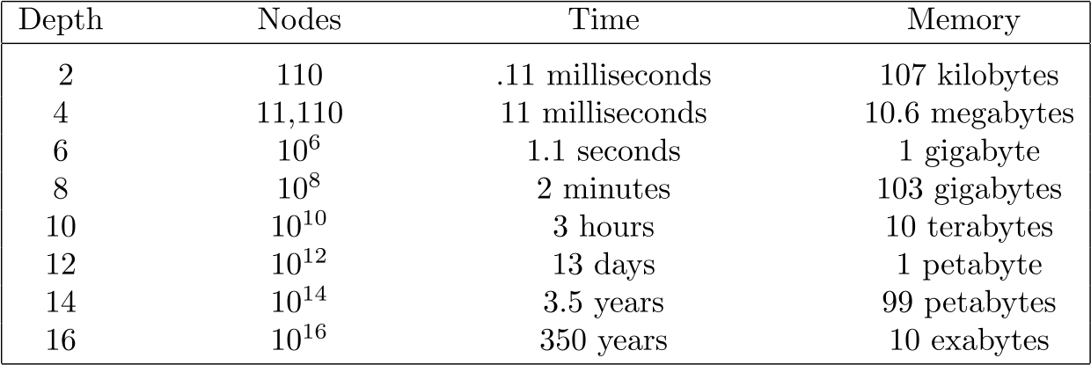
BFS Properties
Complete
Optimal
Complexity
Time
Space
Assume: b = 10, 1 million nodes/second, 1000 bytes/node
http://aima.cs.berkeley.edu/
b: maximum branching factor of the search tree
d: depth of the shallowest solution
Notes:
In the figure, nodes, denotes the number of nodes explored.

Slide 38
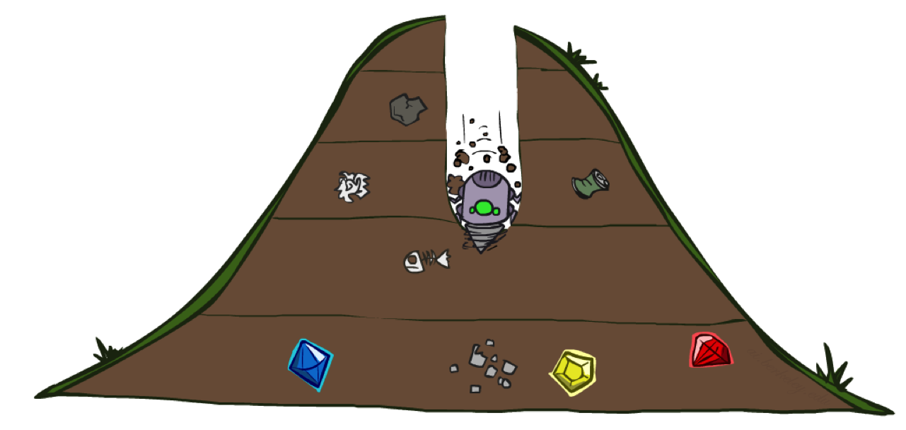
DFS
DFS explores the deepest node in the search tree
http://ai.berkeley.edu
frontier is a stack (last in first out data structure)

Slide 39
Stack in Python
We are going to use the deque in Python
Example usage:
>>> import collections >>> queue = collections.deque(['A', 'B', 'C', 'D']) >>> queue.pop() 'D' >>> queue deque(['A', 'B', 'C']) >>> queue.pop() 'C' >>> queue deque(['A', 'B'])

Slide 40
import collections def dfsGsa(stateSpaceGraph, startState, goalState): frontier = collections.deque([startState]) exploredSet = set() print('Initial frontier:',list(frontier)) input() while frontier: node = frontier.pop() if (node.endswith(goalState)): return node if node[-1] not in exploredSet: print('Exploring:',node[-1],'...') exploredSet.add(node[-1]) for child in stateSpaceGraph[node[-1]]: frontier.append(node+child) print(list(frontier)) print(exploredSet) input() romania = { 'A':['S','T','Z'],'Z':['A','O'],'O':['S','Z'],'T':['A','L'],'L':['M','T'],'M':['D','L'], 'D':['C','M'],'S':['A','F','O','R'],'R':['C','P','S'],'C':['D','P','R'], 'F':['B','S'],'P':['B','C','R'],'B':[] } print('Solution path:',dfsGsa(romania, 'A', 'B'))

Slide 41
DFS-GSA Romania
Initial frontier: ['A'] Exploring: A ... ['AS', 'AT', 'AZ'] {'A'} Exploring: Z ... ['AS', 'AT', 'AZA', 'AZO'] {'Z', 'A'} Exploring: O ... ['AS', 'AT', 'AZA', 'AZOS', 'AZOZ'] {'Z', 'O', 'A'} Exploring: S ... ['AS', 'AT', 'AZA', 'AZOSA', 'AZOSF', 'AZOSO', 'AZOSR'] {'Z', 'O', 'S', 'A'} Exploring: R ... ['AS', 'AT', 'AZA', 'AZOSRC', 'AZOSRP', 'AZOSRS'] {'A', 'Z', 'R', 'O', 'S'} Exploring: P ... ['AS', 'AT', 'AZA', --- 'AZOSRPB', 'AZOSRPC', 'AZOSRPR'] {'A', 'P', 'Z', 'R', 'O', 'S'} Exploring: C ... ['AS', 'AT', 'AZA', --- 'AZOSRPCD', 'AZOSRPCP', 'AZOSRPCR'] {'C', 'A', 'P', 'Z', 'R', 'O', 'S'} Exploring: D ... ['AS', 'AT', 'AZA', --- 'AZOSRPB', 'AZOSRPCDC', 'AZOSRPCDM'] {'D', 'C', 'A', 'P', 'Z', 'R', 'O', 'S'}
http://aima.cs.berkeley.edu/

Slide 42
... Exploring: M ... ['AS', 'AT', 'AZA', --- 'AZOSRPCDC', 'AZOSRPCDMD', 'AZOSRPCDML'] {'D', 'C', 'A', 'P', 'Z', 'R', 'O', 'S', 'M'} Exploring: L ... ['AS', 'AT', 'AZA', --- 'AZOSRPCDMD', 'AZOSRPCDMLM', 'AZOSRPCDMLT'] {'D', 'C', 'A', 'P', 'Z', 'R', 'L', 'O', 'S', 'M'} Exploring: T ... ['AS', 'AT', 'AZA', --- 'AZOSRPCDMLM', 'AZOSRPCDMLTA', 'AZOSRPCDMLTL'] {'D', 'C', 'A', 'P', 'Z', 'T', 'R', 'L', 'O', 'S', 'M'} Solution path: AZOSRPB
http://aima.cs.berkeley.edu/
Try it here
dfsTsaRomania.py
dfsGsaRomania.py

Slide 43
DFS-TSA Practice
Consider the following state space graph
Let S be the start state and G be the goal state
Perform DFS-TSA and write down the order of explored states
Assume children are added into the frontier in alphabetical order
10
5
2
a
b
c
4
3
S
1
1
G
3
2
4
d
e

Slide 44
DFS-TSA Practice Solution
Initial frontier: ['S'] Exploring: S ... ['Sa', 'Sd', 'SG'] Solution path: SG
10
5
2
a
b
c
4
3
S
1
1
G
3
2
4
Try it here
dfsTsaPractice.py
dfsGsaPractice.py
d
e

Slide 45
DFS Properties
Complete: Always find a solution if one exists?
Optimal: Always find a least-cost solution?
Complexity
Time: Number of nodes generated
Space: Max number of nodes in memory
b: maximum branching factor of the search tree
m: maximum length of any path in the state space

Slide 46
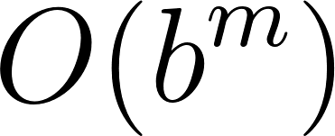
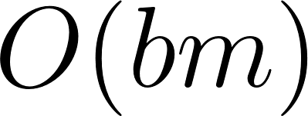
DFS Properties (TSA version)
Complete: Always find a solution if one exists?
May fail in spaces with loops
Optimal: Always find a least-cost solution?
No, returns the first solution in finds
Complexity
Time: Number of nodes generated, worst case
Space: Max number of nodes in memory
b: maximum branching factor of the search tree
m: maximum length of any path in the state space

Slide 47
BFS vs. DFS
When will BFS outperform DFS?
If solutions are close to the root of the search tree
When will DFS outperform BFS?
If all solutions are deep inside the search tree

Slide 48
GSA vs. TSA
GSA
Avoids infinite loops
Eliminates exponentially many redundant paths
Requires memory proportional to its runtime
TSA
Could be stuck in infinite loops
Explores redundant paths
Requires less memory
Easier to implement

Slide 49
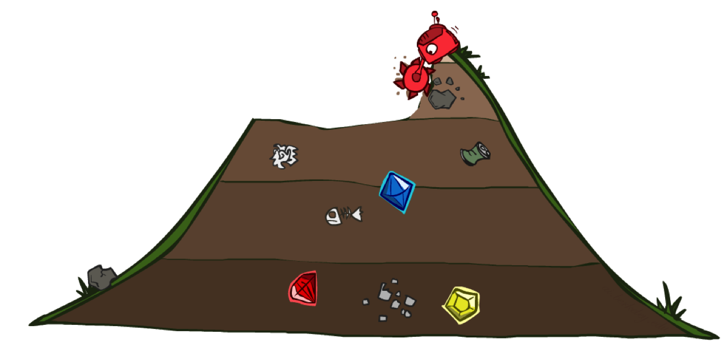
UCS
UCS explores the cheapest node first
http://ai.berkeley.edu
frontier is a priority queue (queue data structure where each element has a priority)
Notes:
Could UCS-TSA be stuck in infinite loop?

Slide 50
Updated Romania Problem Definition
Updated version includes the distances
This is the cost
from O to Z
romania = { 'A':[(140,'S'),(118,'T'),(75,'Z')],'Z':[(75,'A'),(71,'O')],'O':[(151,'S'),(71,'Z')], 'T':[(118,'A'),(111,'L')],'L':[(70,'M'),(111,'T')],'M':[(75,'D'),(70,'L')], 'D':[(120,'C'),(75,'M')],'S':[(140,'A'),(99,'F'),(151,'O'),(80,'R')], 'R':[(146,'C'),(97,'P'),(80,'S')],'C':[(120,'D'),(138,'P'),(146,'R')], 'F':[(211,'B'),(99,'S')],'P':[(101,'B'),(138,'C'),(97,'R')],'B':[]}

Slide 51
Priority Queue in Python
We will use this library for our Priority Queue
frontier = [] >>> from heapq import heappush, heappop import random >>> heappush(frontier, (random.randint(1, 10), 'A')) >>> heappush(frontier, (random.randint(1, 10), 'B')) >>> heappush(frontier, (random.randint(1, 10), 'C')) >>> frontier [(2, 'C'), (7, 'B'), (6, 'A')] >>> heappop(frontier) (2, 'C') >>> heappop(frontier) (6, 'A') >>> heappop(frontier) (7, 'B') >>> (1, 'B') < (2, 'A') True >>> (1, 'B') < (1, 'A') False
This is how tuples are compared in Python

Slide 52
from heapq import heappush, heappop def ucsGsa(stateSpaceGraph, startState, goalState): frontier = [] heappush(frontier, (0, startState)) exploredSet = set() print('Initial frontier:',list(frontier)); input() while frontier: node = heappop(frontier) if (node[1].endswith(goalState)): return node if node[1][-1] not in exploredSet: print('Exploring:',node[1][-1],'at cost',node[0]) exploredSet.add(node[1][-1]) for child in stateSpaceGraph[node[1][-1]]: heappush(frontier, (node[0]+child[0], node[1]+child[1])) print(list(frontier)); print(exploredSet); input() romania = { 'A':[(140,'S'),(118,'T'),(75,'Z')],'Z':[(75,'A'),(71,'O')],'O':[(151,'S'),(71,'Z')], 'T':[(118,'A'),(111,'L')],'L':[(70,'M'),(111,'T')],'M':[(75,'D'),(70,'L')], 'D':[(120,'C'),(75,'M')],'S':[(140,'A'),(99,'F'),(151,'O'),(80,'R')], 'R':[(146,'C'),(97,'P'),(80,'S')],'C':[(120,'D'),(138,'P'),(146,'R')], 'F':[(211,'B'),(99,'S')],'P':[(101,'B'),(138,'C'),(97,'R')],'B':[]} print('Solution path:',ucsGsa(romania, 'A', 'B'))
http://aima.cs.berkeley.edu/

Slide 53
DFS-GSA Romania
Initial frontier: [(0, 'A')] Exploring: A at cost 0 [(75, 'AZ'), (140, 'AS'), (118, 'AT')] {'A'} Exploring: Z at cost 75 [(118, 'AT'), (140, 'AS'), (150, 'AZA'), (146, 'AZO')] {'Z', 'A'} Exploring: T at cost 118 [(140, 'AS'), (146, 'AZO'), (150, 'AZA'), (236, 'ATA'), (229, 'ATL')] {'Z', 'T', 'A'} Exploring: S at cost 140 [(146, 'AZO'), (220, 'ASR'), --- (291, 'ASO'), (236, 'ATA')] {'Z', 'T', 'A', 'S'} Exploring: O at cost 146 [(150, 'AZA'), (217, 'AZOZ'), --- (297, 'AZOS'), (229, 'ATL')] {'A', 'O', 'S', 'Z', 'T'} Exploring: R at cost 220 [(229, 'ATL'), (280, 'ASA'), --- (317, 'ASRP'), (300, 'ASRS')] {'R', 'A', 'O', 'S', 'Z', 'T'} Exploring: L at cost 229 [(236, 'ATA'), (280, 'ASA'), --- (299, 'ATLM'), (340, 'ATLT')] {'R', 'A', 'O', 'S', 'L', 'Z', 'T'} Exploring: F at cost 239 [(280, 'ASA'), (291, 'ASO'), --- (450, 'ASFB'), (338, 'ASFS')] {'R', 'A', 'O', 'S', 'L', 'F', 'Z', 'T'}
http://aima.cs.berkeley.edu/

Slide 54
... Exploring: M at cost 299 [(300, 'ASRS'), (317, 'ASRP'), --- (374, 'ATLMD'), (369, 'ATLML')] {'M', 'R', 'A', 'O', 'S', 'L', 'F', 'Z', 'T'} Exploring: P at cost 317 [(338, 'ASFS'), (369, 'ATLML'), --- (455, 'ASRPC'), (414, 'ASRPR')] {'M', 'P', 'R', 'A', 'O', 'S', 'L', 'F', 'Z', 'T'} Exploring: C at cost 366 [(369, 'ATLML'), (374, 'ATLMD'), --- (504, 'ASRCP'), (512, 'ASRCR')] {'M', 'P', 'R', 'A', 'O', 'S', 'L', 'F', 'Z', 'T', 'C'} Exploring: D at cost 374 [(414, 'ASRPR'), (418, 'ASRPB'), --- (504, 'ASRCP'), (494, 'ATLMDC')] {'M', 'P', 'R', 'A', 'D', 'O', 'S', 'L', 'F', 'Z', 'T', 'C'} Solution path: (418, 'ASRPB')
http://aima.cs.berkeley.edu/
Try it here
ucsTsaRomania.py
ucsGsaRomania.py

Slide 55
UCS-GSA Practice
Consider the following state space graph
Let S be the start state and G be the goal state
Perform UCS-GSA and write down the order of explored states
Assume children are added into the frontier in alphabetical order
10
5
2
a
b
c
4
3
S
1
1
G
3
2
4
d
e

Slide 56
10
5
2
a
b
c
4
3
S
1
1
G
3
2
4
d
e
Initial frontier: [(0, 'S')] Exploring: S at cost 0 [(2, 'Sd'), (3, 'Sa'), (10, 'SG')] {'S'} Exploring: d at cost 2 [(3, 'Sa'), (6, 'Sde'), (3, 'Sdb'), (10, 'SG')] {'S', 'd'} Exploring: a at cost 3 [(3, 'Sdb'), (6, 'Sde'), (10, 'SG'), (8, 'Sab')] {'S', 'a', 'd'}

Slide 57
10
5
2
a
b
c
4
3
S
1
1
G
3
2
4
d
e
... Exploring: b at cost 3 [(4, 'Sdbe'), (5, 'Sdbc'), (10, 'SG'), (8, 'Sab'), (6, 'Sde')] {'b', 'S', 'a', 'd'} Exploring: e at cost 4 [(5, 'Sdbc'), (6, 'Sde'), (10, 'SG'), (8, 'Sab'), (7, 'SdbeG')] {'S', 'e', 'd', 'a', 'b'} Exploring: c at cost 5 [(6, 'Sde'), (7, 'SdbeG'), (10, 'SG'), (8, 'Sab'), (9, 'SdbcG')] {'S', 'e', 'd', 'c', 'a', 'b'} Solution path: (7, 'SdbeG')
Try it here
ucsTsaPractice.py
ucsGsaPractice.py

Slide 58
UCS Properties
Complete: Always find a solution if one exists?
Optimal: Always find a least-cost solution?
Complexity
Time: Number of nodes generated
Space: Max number of nodes in memory
C*: cost of optimal solution
epsilon: smallest path cost in search graph

Slide 59
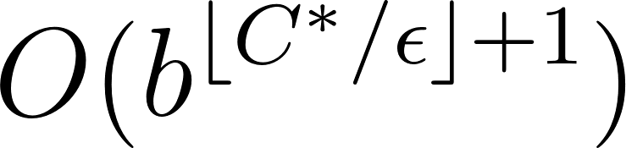
UCS Properties
Complete: Always find a solution if one exists?
Yes if every cost is positive
Optimal: Always find a least-cost solution?
Yes, nodes expand in increasing order of cost
Complexity
Time: Number of nodes generated
Space: Max number of nodes in memory
C*: cost of optimal solution
epsilon: smallest path cost in search graph

Slide 60
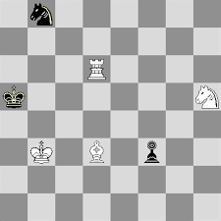
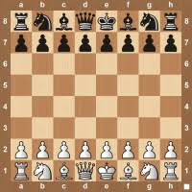
Chess – State Space
States
Any arrangement of pieces on the chess board
Initial state
The initial setting
Actions and Transition model
Possible moves of each piece
Goal test
Anyone win the game, i.e. capture the King

Slide 61
